Slide 1
Project
Telecom Customer Churn Analysis
Introduction to Churn Analysis
In today's competitive business environment, retaining customers is crucial for long-term success. Churn analysis is a key technique used to understand and reduce this customer attrition. It involves examining customer data to identify patterns and reasons behind customer departures. By using advanced data analytics and machine learning, businesses can predict which customers are at risk of leaving and understand the factors driving their decisions. This knowledge allows companies to take proactive steps to improve customer satisfaction and loyalty.
Although this project focuses on churn analysis for a telecom firm, the techniques and insights are applicable across various industries. From retail and finance to healthcare and beyond, any business that values customer retention can benefit from churn analysis. We will explore the methods, tools, and best practices for reducing churn and improving customer loyalty, transforming data into actionable insights for sustained success.

Slide 2
Todays Agenda
Project Goals
Create an Entire ETL Process in a database and a Power BI Dashboard to Utilize the customer Data and achieve below goals:
Analyse customer Data at below levels
a. Demographic
b. Geographic
c. Payment & Account Info
d. Services
2.Study churn profile identify areas for implementing marketing campaigns
3. Identify a method to Predict Future churners
Metrics Required
Total Customers
Total Churn & Churn Rate
New Joiners

Slide 3
ETL Framework
Our Framework uses below components :
csv file – This is our source file
SQL Management studio – we will use its inbuilt import wizard to
transform & load the data.
SQL Server Database - This is where our final data will be loaded and host our data warehouse , tables , views for final usage.
Alternative framework:
csv file – This is our source file
SQL server integration services – we can use custom made SSIS package to transform & load data . This is usually used when you have recurring data loads and you want to automate the process
SQL Server Database – Package loads our final data into data warehouse in SQL Server

Slide 4
Steps in ETL Process:
Create a Database
Create a Table
Load Data
Views
A view is a virtual table in database that displays data from one or more tables through a predefined query .
It does not store the data itself but provides a way to
Look at and interact with the data from the underlying tables as if it is were a regular table.
STEP 1 - ETL Process in SQL Server
So the first step in churn analysis is to load the data from our source file. For this purpose we will be using Microsoft SQL server because it is a widely used solution across the industry and also because a full-fledged Database System is better at handling recurring data loads and maintaining data integrity compared to an excel file.
Download SSMS
In order for us to run our sql queries Microsoft provides us with GUI interface which is known as SQL Server Management Studio. You can download the latest version from the link provided below.
https://learn.microsoft.com/en-us/sql/ssms/download-sql-server-management-studio-ssms?view=sql-server-ver16

Slide 5
Creating Database
After installation, you will land on the following screen. Do remember to copy paste the server name somewhere because we will need this at a later stage. Also enable the checkbox which says “Trust Server Certificate” and then click on Connect
Once connected, click on NEW QUERY button at the top ribbon and then write below query. This will create a new Database named db_Churn
CREATE DATABASE db_Churn
Import csv into SQL server staging table – Import Wizard
Right click on the newly created database in the explorer window and then go to
Task >> Import >> Flat file >> Browse CSV file
Note:
Remember to add customerId as primary key and allow nulls for all remaining columns. This is done to avoid any errors while data load. Also make sure to change the datatype where it say Bit to Varchar(50). We are doing this because while using import wizard I faced issues with the BIT data type, however Varchar(50) works fine.

Slide 6
Data Exploration – Check Distinct Values
SELECT Gender, Count(Gender) as TotalCount,
Count(Gender) 1.0 / (Select Count() from db. churn_Data) as Percentage
from db.churn_Data
Group by Gender
SELECT Contract, Count(Contract) as TotalCount,
Count(Contract) 1.0 / (Select Count() from churn_Data) as Percentage
from churn_Data
Group by Contract
SELECT Customer_Status, Count(Customer_Status) as TotalCount, Sum(Total_Revenue) as TotalRev,
Sum(Total_Revenue) / (Select sum(Total_Revenue) from stg_Churn) * 100 as RevPercentage
from churn_Data
Group by Customer_Status
SELECT State, Count(State) as TotalCount,
Count(State) 1.0 / (Select Count() from stg_Churn) as Percentage
from churn_Data
Group by State
Order by Percentage desc

Slide 7
Data Exploration – Check Nulls
SELECT
SUM(CASE WHEN Customer_ID IS NULL THEN 1 ELSE 0 END) AS Customer_ID_Null_Count,
SUM(CASE WHEN Gender IS NULL THEN 1 ELSE 0 END) AS Gender_Null_Count,
SUM(CASE WHEN Age IS NULL THEN 1 ELSE 0 END) AS Age_Null_Count,
SUM(CASE WHEN Married IS NULL THEN 1 ELSE 0 END) AS Married_Null_Count,
SUM(CASE WHEN State IS NULL THEN 1 ELSE 0 END) AS State_Null_Count,
SUM(CASE WHEN Number_of_Referrals IS NULL THEN 1 ELSE 0 END) AS Number_of_Referrals_Null_Count,
SUM(CASE WHEN Tenure_in_Months IS NULL THEN 1 ELSE 0 END) AS Tenure_in_Months_Null_Count,
SUM(CASE WHEN Value_Deal IS NULL THEN 1 ELSE 0 END) AS Value_Deal_Null_Count,
SUM(CASE WHEN Phone_Service IS NULL THEN 1 ELSE 0 END) AS Phone_Service_Null_Count,
SUM(CASE WHEN Multiple_Lines IS NULL THEN 1 ELSE 0 END) AS Multiple_Lines_Null_Count,
SUM(CASE WHEN Internet_Service IS NULL THEN 1 ELSE 0 END) AS Internet_Service_Null_Count,
SUM(CASE WHEN Internet_Type IS NULL THEN 1 ELSE 0 END) AS Internet_Type_Null_Count,
SUM(CASE WHEN Online_Security IS NULL THEN 1 ELSE 0 END) AS Online_Security_Null_Count,
SUM(CASE WHEN Online_Backup IS NULL THEN 1 ELSE 0 END) AS Online_Backup_Null_Count,
SUM(CASE WHEN Device_Protection_Plan IS NULL THEN 1 ELSE 0 END) AS Device_Protection_Plan_Null_Count,
SUM(CASE WHEN Premium_Support IS NULL THEN 1 ELSE 0 END) AS Premium_Support_Null_Count,
SUM(CASE WHEN Streaming_TV IS NULL THEN 1 ELSE 0 END) AS Streaming_TV_Null_Count,
SUM(CASE WHEN Streaming_Movies IS NULL THEN 1 ELSE 0 END) AS Streaming_Movies_Null_Count,
SUM(CASE WHEN Streaming_Music IS NULL THEN 1 ELSE 0 END) AS Streaming_Music_Null_Count,
SUM(CASE WHEN Unlimited_Data IS NULL THEN 1 ELSE 0 END) AS Unlimited_Data_Null_Count,
SUM(CASE WHEN Contract IS NULL THEN 1 ELSE 0 END) AS Contract_Null_Count,
SUM(CASE WHEN Paperless_Billing IS NULL THEN 1 ELSE 0 END) AS Paperless_Billing_Null_Count,
SUM(CASE WHEN Payment_Method IS NULL THEN 1 ELSE 0 END) AS Payment_Method_Null_Count,
SUM(CASE WHEN Monthly_Charge IS NULL THEN 1 ELSE 0 END) AS Monthly_Charge_Null_Count,
SUM(CASE WHEN Total_Charges IS NULL THEN 1 ELSE 0 END) AS Total_Charges_Null_Count,
SUM(CASE WHEN Total_Refunds IS NULL THEN 1 ELSE 0 END) AS Total_Refunds_Null_Count,
SUM(CASE WHEN Total_Extra_Data_Charges IS NULL THEN 1 ELSE 0 END) AS Total_Extra_Data_Charges_Null_Count,
SUM(CASE WHEN Total_Long_Distance_Charges IS NULL THEN 1 ELSE 0 END) AS Total_Long_Distance_Charges_Null_Count,
SUM(CASE WHEN Total_Revenue IS NULL THEN 1 ELSE 0 END) AS Total_Revenue_Null_Count,
SUM(CASE WHEN Customer_Status IS NULL THEN 1 ELSE 0 END) AS Customer_Status_Null_Count,
SUM(CASE WHEN Churn_Category IS NULL THEN 1 ELSE 0 END) AS Churn_Category_Null_Count,
SUM(CASE WHEN Churn_Reason IS NULL THEN 1 ELSE 0 END) AS Churn_Reason_Null_Count
FROM churn_Data;

Slide 8
Remove null and insert the new data into Prod table
SELECT
Customer_ID,
Gender,
Age,
Married,
State,
Number_of_Referrals,
Tenure_in_Months,
ISNULL(Value_Deal, 'None') AS Value_Deal,
Phone_Service,
ISNULL(Multiple_Lines, 'No') As Multiple_Lines,
Internet_Service,
ISNULL(Internet_Type, 'None') AS Internet_Type,
ISNULL(Online_Security, 'No') AS Online_Security,
ISNULL(Online_Backup, 'No') AS Online_Backup,
ISNULL(Device_Protection_Plan, 'No') AS Device_Protection_Plan,
ISNULL(Premium_Support, 'No') AS Premium_Support,
ISNULL(Streaming_TV, 'No') AS Streaming_TV,
ISNULL(Streaming_Movies, 'No') AS Streaming_Movies,
ISNULL(Streaming_Music, 'No') AS Streaming_Music,
ISNULL(Unlimited_Data, 'No') AS Unlimited_Data,
Contract,
Paperless_Billing,
Payment_Method,
Monthly_Charge,
Total_Charges,
Total_Refunds,
Total_Extra_Data_Charges,
Total_Long_Distance_Charges,
Total_Revenue,
Customer_Status,
ISNULL(Churn_Category, 'Others') AS Churn_Category,
ISNULL(Churn_Reason , 'Others') AS Churn_Reason
INTO [db_Churn].[dbo].[prod_Churn]
FROM [db_Churn].[dbo].[stg_Churn];

Slide 9
Create View for Power BI
Create View vw_ChurnData as
select * from prod_Churn where Customer_Status In ('Churned', 'Stayed')
Create View vw_JoinData as
select * from prod_Churn where Customer_Status = 'Joined'
STEP 2 - Power BI Transform
Add a new column in prod_Churn
1. Churn Status = if [Customer_Status] = "Churned" then 1 else 0
2. Change Churn Status data type to numbers
3. Monthly Charge Range = if [Monthly_Charge] < 20 then "< 20" else if [Monthly_Charge] < 50 then "20-50" else if [Monthly_Charge] < 100 then "50-100" else "> 100"
Create a New Table Reference for mapping_AgeGrp
1. Keep only Age column and remove duplicates
2. Age Group = if [Age] < 20 then "< 20" else if [Age] < 36 then "20 - 35" else if [Age] < 51 then "36 - 50" else "> 50"
3. AgeGrpSorting = if [Age Group] = "< 20" then 1 else if [Age Group] = "20 - 35" then 2 else if [Age Group] = "36 - 50" then 3 else 4
4. Change data type of AgeGrpSorting to Numbers

Slide 10
Create a new table reference for MappingTenure Grp
1. Keep only TenureinMonths and remove duplicates
2. Tenure Group = if [Tenure_in_Months] < 6 then "< 6 Months" else if [Tenure_in_Months] < 12 then "6-12 Months" else if [Tenure_in_Months] < 18 then "12-18 Months" else if [Tenure_in_Months] < 24 then "18-24 Months" else ">= 24 Months"
3. TenureGrpSorting = if [Tenure_in_Months] = "< 6 Months" then 1 else if [Tenure_in_Months] = "6-12 Months" then 2 else if [Tenure_in_Months] = "12-18 Months" then 3 else if [Tenure_in_Months] = "18-24 Months " then 4 else 5
4. Change data type of TenureGrpSorting to Numbers
Create a new table reference for prod_Services
1. Unpivot services columns
2. Rename Column – Attribute >> Services & Value >> Status
STEP 3 - Power BI Measure
Total Customers = Count(prod_Churn[Customer_ID])
New Joiners = CALCULATE(COUNT(prod_Churn[Customer_ID]), prod_Churn[Customer_Status] = "Joined")
Total Churn = SUM(prod_Churn[Churn Status])
Churn Rate = [Total Churn] / [Total Customers]

Slide 11
STEP 4 - Power BI Visualization
Summary Page
1. Top Card
a. Total Customers
b. New Joiners
c. Total Churn
d. Churn Rate%
2. Demographic
a. Gender – Churn Rate
b. Age Group – Total Customer & Churn Rate
3. Account Info
a. Payment Method – Churn Rate
b. Contract – Churn Rate
c. Tenure Group - Total Customer & Churn Rate
4. Geographic
a. Top 5 State – Churn Rate
5. Churn Distribution
a. Churn Category – Total Churn
b. Tooltip : Churn Reason – Total Churn
6. Service Used
a. Internet Type – Churn Rate
b. prod_Service >> Services – Status – % RT Sum of Churn Status
Churn Reason Page (Tooltip)
1. Churn Reason – Total Churn

Slide 12
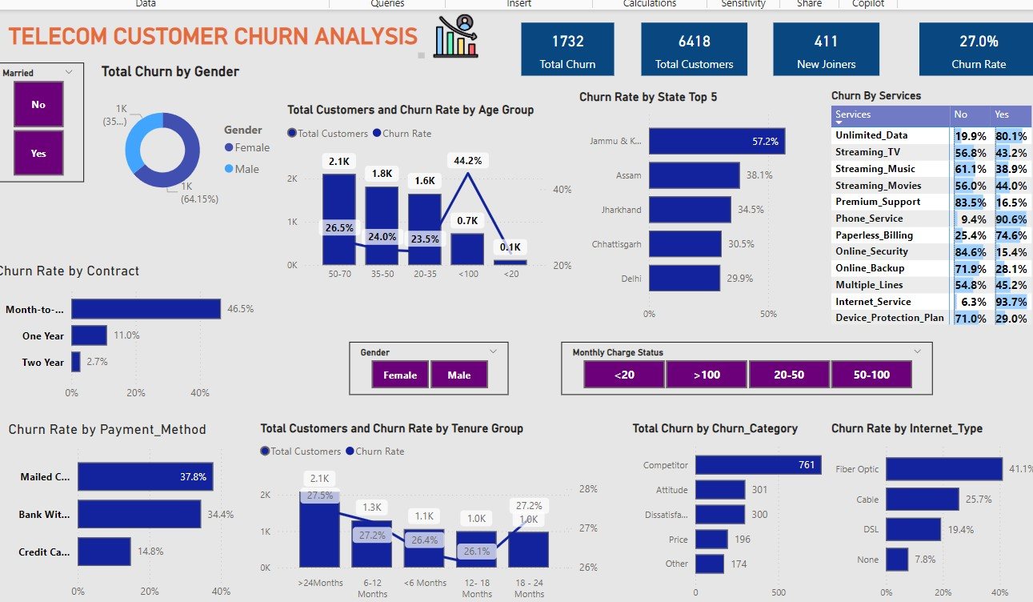
Dashboard with Power bi

Slide 13
Call Center Analysis Insights
1. Demographic-Based Insights
Age Group Analysis
Insight:
The 50-70 age group represents the largest segment of customers, accounting for 32.83% of the total customer base. The 50-70 age group had the highest number of total customers at 1,700.85% more than the under 20 group, which had the lowest at 117.
Gender-Based Churn Analysis
Insight:
Churn is higher for Female customers (1111 churns) than for Male customers (621 churns).
Customer Tenure Group Analysis
Insight:
Tenure-based Segmentation: Customers' churn rates ranged from 26.1% to 27.5% across all tenure groups, with a significant divergence in Total Customers and Churn Rate when the tenure group was >24 months (Total Customers = 2087, Churn Rate = 26.1%).

Slide 14
2. Geographic-Based Insights
Geographic Trends in Churn
Insight:
Although the specific geographic regions aren't mentioned in the original data, geographic trends often show that certain regions may have higher churn rates or customer engagement levels based on factors like competition, regional pricing, or localized customer service quality.
3. Time Series-Based Insights
Churn Rate and Customer Trends Over Time
Insight:
Consistent Churn Rates: Churn rates across all tenure groups remain consistent, ranging from 26.1% to 27.5%, suggesting that churn is not solely linked to customer tenure but may be influenced by time-based factors such as seasonal changes, product lifecycle stages, or broader economic conditions.
High Call Volume During Specific Time Periods: Calls tend to increase at specific times of day or seasons, with higher volumes seen during certain months, holidays, or product launches.

Slide 15
Summary of Insights by Category
Demographic Insights:
50-70 Age Group: Largest customer segment with high retention potential. Focus on personalized retention and customer support.
Under 20 Age Group: Smallest segment. Explore ways to engage younger customers via digital channels and incentives.
Higher Female Churn: Investigate the specific reasons for higher churn among female customers and design targeted retention strategies.
Long-Tenure Customers (24+ months): Higher churn despite large customer base. Offer loyalty rewards and proactive engagement to reduce churn.
Geographic Insights:
Regional Churn Patterns: Perform a geographic breakdown of churn and customer satisfaction to address regional disparities.
Localized Retention Strategies: Tailor customer retention efforts based on regional trends, competition, and local preferences.
Time Series Insights:
Consistent Churn Rate: Churn is stable across tenure groups, suggesting potential seasonal or systemic issues that should be addressed.
Time-Based Trends: Utilize time-based analysis to anticipate high-demand periods, optimize workforce management, and reduce churn during peak seasons.

Slide 16
Recommendations
Tailor Engagement Strategies: Personalize retention efforts based on demographic groups (age, gender, and tenure). Focus on high-value segments like the 50-70 age group, while also engaging younger (<20) customers through digital channels.
Address Gender-Specific Needs: Investigate and mitigate churn reasons specific to female customers by offering tailored solutions, improving support, and enhancing communication.
Proactively Engage Long-Tenure Customers: Design programs that reward long-term loyalty and engage customers who have been with the company for over 24 months to prevent churn.
Regional Customization: Use geographic insights to implement targeted marketing or customer service strategies based on regional trends and customer needs.
Leverage Time Series Data for Planning: Use historical data to predict and plan for seasonal changes in churn and customer call volume. Adjust staffing, promotions, and retention efforts accordingly to reduce churn during peak periods.
Improve Product and Service Offerings Over Time: Analyze time-based trends in customer satisfaction to ensure products and services remain relevant and valuable, preventing churn from product fatigue or dissatisfaction.
By leveraging insights across demographic, geographic, and time series dimensions, the call center can implement data-driven strategies to enhance customer retention, improve engagement, and ultimately reduce churn across key customer segments.

